Slide 1
hadoop mapreduce
results
data
lg model
intro
conclusion
decision tree
proposal
random forest
Evaluation of Credit Card Fraud Detection

Slide 2


what is fraud?
the illegal and unwelcome use of a card by someone other than the card's rightful owner
results
lg model
data
intro
conclusion
decision tree
proposal
random forest
fraud detection
Monitoring user activity, with an eye toward estimating, perceiving, or avoiding fraudulent, intrusive, or defaulting behavior.

Slide 3
our goal
To examine previous transaction information of customers and extract behavioral patterns, therefore a unique fraud detection approach for Streaming Transaction Data is also being designed and developed.
results
lg model
data
intro
conclusion
decision tree
proposal
random forest
random forest
algorithm
logistic regression model
confusion matrix

Slide 4
data sets
2
unique data sets
Credit card transactions from a large Brazilian bank and the Kaggle website covering the entire year of 2019 were collected into a massive dataset.
columns representing different fields
17
results
intro
lg model
data
conclusion
decision tree
proposal
random forest
A data sample is generated for evaluation purposes.
Using the data from the sample tests and the outcomes of the combined algorithm, a forecast can be made.

Slide 5

data sets cont.
We first do an exploratory data analysis in order to determine which elements of the training data could be connected to fraudulent behaviors.
We next attempt to build models with these features and evaluate their predictive efficacy.
After, bar charts depicting the accuracy and efficiency test outcomes are shown.
A built-in check makes sure the results are correct by confirming the legitimacy of the deal.
If suspicious behavior is detected, the bank is informed.
results
intro
lg model
data
conclusion
decision tree
proposal
random forest

Slide 6
method
Machine learning techniques such as logistic regression and decision trees are used to identify fraudulent activity.
Whether or not a pending transaction is legitimate depends on an analytical model
results
intro
lg model
Specifically, we employ a pair of models for classifying potential instances of fraud.
data
conclusion
decision tree
proposal
random forest
The model was developed using information from financial institutions that accept credit cards.

Slide 7

logistic regression model
In order to classify potential instances of fraud, we are using Logistic Regression.
The logistic curve is used in the fraud detection technique known as logistic regression, which is a sort of probabilistic statistical classification model.
The likelihood that a given tuple belongs to a certain class is denoted by P, whereas the opposite, 1-P, represents the likelihood that it does not.
To increase the likelihood of incoming transactions, the model optimizes the values of coefficients C0 and C1.
results
intro
data
lg model
conclusion
decision tree
proposal
random forest
For a univariate logistic curve, use the following formula.

Slide 8
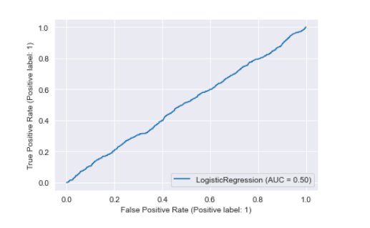
logistic regression model
Accuracy: 0.005649933355406702
Precision: 0.005649933355406702
Recall: 1.0
F1 Score: 0.011236381901911703
ROC AUC Score: 0.5
Confusion Matrix: <sklearn.metrics._plot.confusion_matrix.ConfusionMatrixDisplay object at 0x7f9592a372b0>
ROC Curve: <sklearn.metrics._plot.roc_curve.RocCurveDisplay object at 0x7f959331bb80>
results
intro
data
lg model
conclusion
decision tree
proposal
random forest

Slide 9

decision tree
While constructing the decision tree, the ID3 method considers the entropy of the dataset.
A set of data's entropy can be used as a measure of its uncertainty. In decision tree design, the entropy of each characteristic is used to determine the criterion for branching.
If we denote the characteristics of the dataset by their probabilities (P1, P2,..., Ps), we get the following.
results
intro
It is possible to derive an equation for the entropy of each possible state.
data
lg model
conclusion
proposal
random forest
decision tree

Slide 10
decision tree
Gain is derived by subtracting the entropy of the whole dataset from the entropy of the attribute used to separate the dataset.
The characteristic with the largest gain is chosen as the tree's starting point, and a decision tree is then constructed from there.
results
intro
It is possible to derive an equation for the entropy of each possible state.
data
lg model
conclusion
proposal
random forest
decision tree

Slide 11
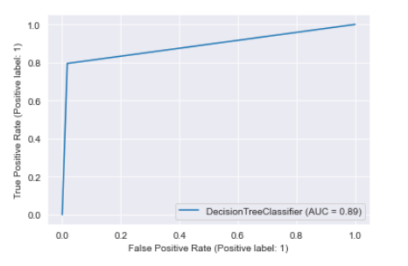
decision tree
Accuracy: 0.9816069412254116
Precision: 0.20672137553731926
Recall: 0.7948910593538693
F1 Score: 0.32811288571871605
ROC AUC Score: 0.8887794635160019
Confusion Matrix: <sklearn.metrics._plot.confusion_matrix.ConfusionMatrixDisplay object at 0x7f959256ef70>
ROC Curve: <sklearn.metrics._plot.roc_curve.RocCurveDisplay object at 0x7f9598593310>
results
intro
data
lg model
conclusion
proposal
random forest
decision tree

Slide 12

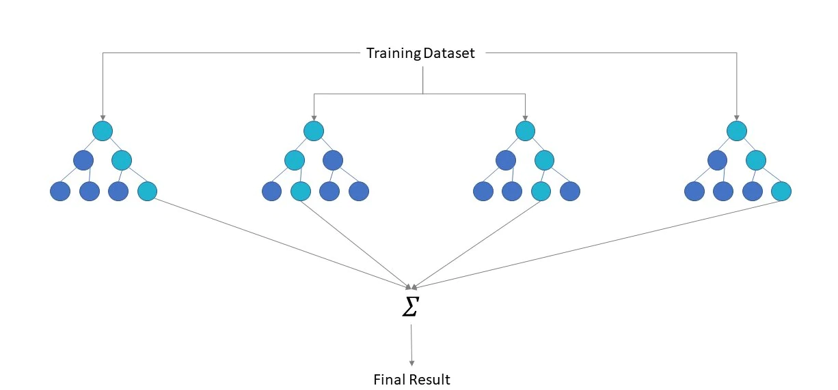
random forest
When attempting to forecast fraudulent transactions, the random forest approach makes use of the pseudocode presented below.
To anticipate the outcome of a transaction and record that prediction, we must Extract the test aspects of incoming transactions; (target)
It is necessary to tally support for each anticipated target output.
Takes into account the highest-ranked forecast from each decision tree when making predictions.
results
intro
data
lg model
conclusion
proposal
decision tree
random forest

Slide 13
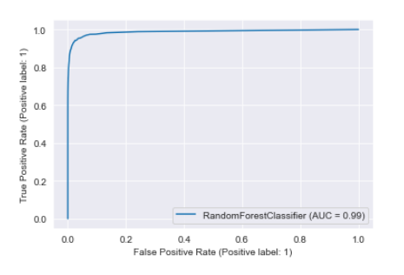
random forest
Accuracy: 0.9965658932497942
Precision: 0.6673076923076923
Recall: 0.7821187077385424
F1 Score: 0.7201660325147007
ROC AUC Score: 0.8899515488600288
Confusion Matrix: <sklearn.metrics._plot.confusion_matrix.ConfusionMatrixDisplay object at 0x7f955a54b580>
ROC Curve: <sklearn.metrics._plot.roc_curve.RocCurveDisplay object at 0x7f955b35dbb0>
results
intro
data
lg model
conclusion
decision tree
proposal
random forest

Slide 14
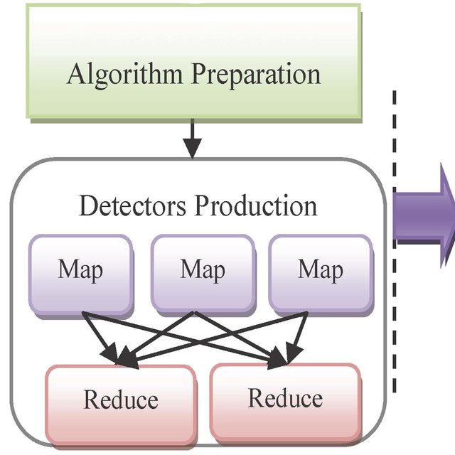
The "MapReduce System" acts as a conductor by coordinating the system's dispersed servers, executing tasks in parallel, controlling data transfers and communications, and ensuring the system's resilience in the face of failure.
Map, Reduce, and Finalize are the three phases of Mapreduce.
results
intro
data
lg model
conclusion
proposal
decision tree
random forest
To identify the fraudulent transactions, Hadoop has been utilized to verify all reported transactions.
Whether or not the transaction is valid, FDS will get paper details on the sum needed to purchase the verification.

Slide 15
results
The results of our EDA, which are presented in the previous slide, reveal that various features of credit card transactions are connected with varying degrees of fraud.
The transaction amount, the age of the credit card user, the spending category, the time of the transaction, and the location of the transaction are all included in these elements.
Following the application of all 3 models to the charge card extortion dataset, the disarray framework is used to evaluate the precision of the logical model. Using the disarray framework as a guide, it is important to learn how well your models can organize tuples in the correct order for both training and evaluation.
Rules such as precession, review, accuracy, and the F1 score are utilized to place the models. The disordered lattice provides an exhaustive discussion of the limits.
results
intro
data
lg model
conclusion
proposal
decision tree
random forest

Slide 16
final thoughts
The models are validated by utilizing the data from the credit cards, and their degree of accuracy is determined with the use of a confusion matrix.
Choose the random forest decision tree as your model of choice if you wish to get the best levels of accuracy, precision, and recall among the three options.
The only other issue that arises with random forest is one of overfitting the tree that is stored in memory when the amount of data increases, but that's about it.
The long-term objective of this work is to solve the overfitting problem of the decision tree and all the other models by using Hadoop Mapreduce and to identify fraudulent transactions in real time for high-rate, streaming, real-world data.
These are all aspects of the problem that need to be addressed.
results
intro
data
lg model
proposal
conclusion
decision tree
random forest

Slide 17
Thank You
results
data
lg model
intro
conclusion
decision tree
proposal
random forest
Lakshmi Dheeraj Ponduri
Sivakrishna Upputuri
Venkatesh Vankayalapati
Kathryn White

